Slide 1


The Characterization of EZ CMa
By: Krister Barclay
Mentor: Dr. Richardson
Undergraduate Research Institution
Embry Riddle Aeronautical University | Prescott, AZ

Slide 2

Overview
Researcher Background
What is a Wolf-Rayet Star?
About WR6
Statement of the Problem
Objectives
Conclusion

Slide 3
Researcher Background
I am an undergraduate Junior at Embry Riddle Aeronautical University (ERAU) | Prescott, AZ.
Currently majoring in Astronomy.
I am just starting this research project about WR6 (EZ CMa) with my mentor Dr. Richardson!

Slide 4
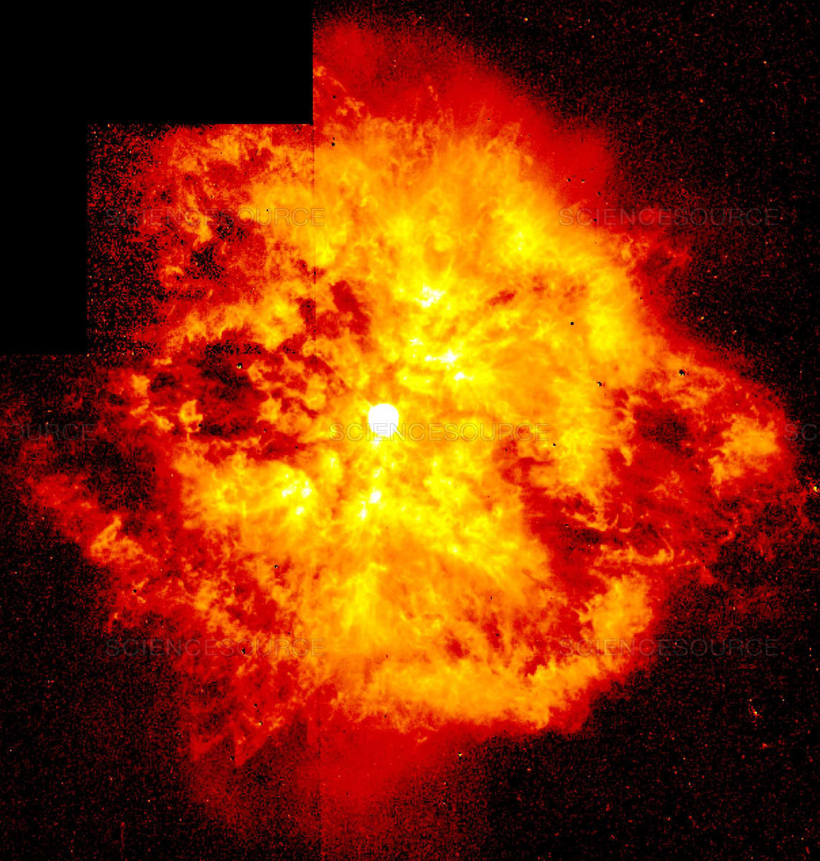
What is a Wolf-Rayet Star?
“Star WR124”
Wolf-Rayet (WR) stars are massive and very hot stars, much greater than that of the Sun (Carrol & Ostlie, 2017).
Strong stellar winds that eject outer layers into the interstellar medium.
Source: https://www.sciencesource.com/CS.aspx?VP3=SearchResult&ITEMID=SS2237125

Slide 5
What is a Wolf-Rayet Star?
Use a process called the CNO cycle: fuses hydrogen into helium (Bradly & Dale, 2017).
WR’s can be split into three categories: WN, WC, WO.
  WN → Nitrogen rich
  WC → Carbon rich
  WO → Oxygen rich

Slide 6
About WR6
WR6 is the brightest Wolf-Rayet (WR) star in Northern Hemisphere.
It’s a runaway star (Gvaramadze, 2020).
Has a 3.77-day period but not consistent with data taken over periods of more than two weeks (Morel, St-Louis, & Marchienko, 1997).
Data of the star was collected from Cerro-Tololo Inter-American Observatory (CTIO) and the observatory from ERAU Prescott campus.

Slide 7
Statement of the Problem
WR6 is controversial on whether it’s a binary system or not.
Goal: show whether this star is a binary or not.
Reason Why it may not a Binary:
Does not produce a double-wave light curve that High Mass X-Ray Binary’s (HMXRB) usually produces (Morel et. al., 1997).
A magnetic field might be present, leading to bright spots on its photosphere.

Slide 8
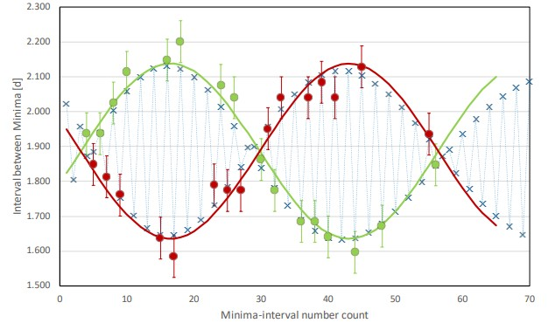
Statement of the Problem
Reason Why it may be a Binary:
Its light curve was interpreted as twice eclipsed observed from BRITE satellite (Schmutz & Koenigsberger, 2019).
The intervals between the minima oscillate between short and long durations.
  This describes “apsidal” motion where the apsidal period is about 100 days.
Source: Schmutz & Koenigsberger, 2019

Slide 9
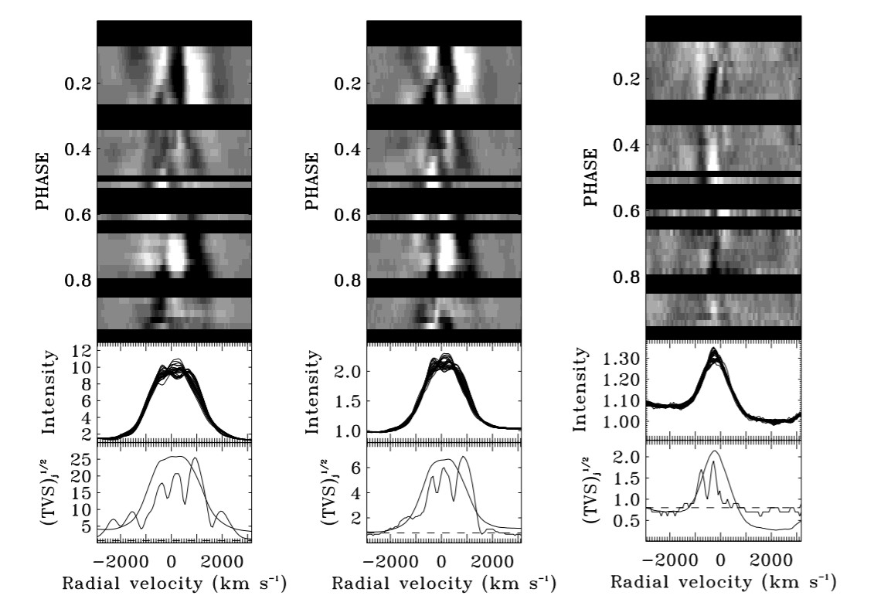
Statement of the Problem
Reason Why it may be a Binary:
The rightmost image seems to show a sinusoidal pattern between black and white colors.
Source: (Morel et. al., 1998)

Slide 10
Objectives
With the data, create a reduction code,
Then create an orbital fit of the system,
Determine if the results from the fit describe the existence of a binary system,
If a companion star is not present, then the stars wind variations can be investigated.

Slide 11
Conclusion
The conclusions of this research can be used to further understand the nature of other WR stars.
Specifically, the findings can be used to observe other WR stars that may be like EZ CMa.
This research will also help the student, his mentor, and the expert scientific community give an understanding of the nature of WR6.

Slide 12
References
Gvaramadze, V. V. “WR6: A Rejuvenated Runaway Star.” Research Notes of the AAS, IOP Publishing, 1 Dec. 2020, iopscience.iop.org/article/10.3847/2515-5172/abceaf.
Schmutz, W., & Koenigsberger, G. (2019). Long uninterrupted photometric observations of the Wolf-Rayet star EZ CMa by the Toronto BRITE satellite reveal a very fast apsidal motion. Astronomy & Astrophysics, 624. doi:10.1051/0004-6361/201935094
Morel, T., St-Louis, N., & Marchienko, S. V. (1997). Optical Spectroscopy of EZ Canis Majoris: Indication for Large-Scale Structures in a Wolf-Rayet Wind. The Astrophysical Journal, 482, 470-489. doi:10.1086/304122
Morel, T., St‐Louis, N., Moffat, A. F., Cardona, O., Koenigsberger, G., & Hill, G. M. (1998). Coupled Line‐Profile and Continuum Variations in EZ Canis Majoris: Implications for the Driving Mechanism of Global Wind Structures in Wolf‐Rayet Winds. The Astrophysical Journal, 498(1), 413-426. doi:10.1086/305548

Slide 13


Slide 14
Insert title of page

